Slide 1
xamarin

Slide 2
Ramin Rowshan
Melika Zare
Introduction and start with xamarin
Coding and Examples

Slide 3
01
02
03
04
xamarin
aspect
Comparison
Installation
Introduction
05
MVVM
Brief Introduction
advantage
And
disadvantage
Differences with competitors
Installation path and size
Model
View
viewmodel

Slide 4

xamarin
Free
Cross-platform
Open source

Slide 5


xamarin
Microsoft
100 percent native
Access to native api
.Net & c #
Share logic with Xamarin.form
Work on all device with ios and android os
Equal with different programing language result

Slide 6
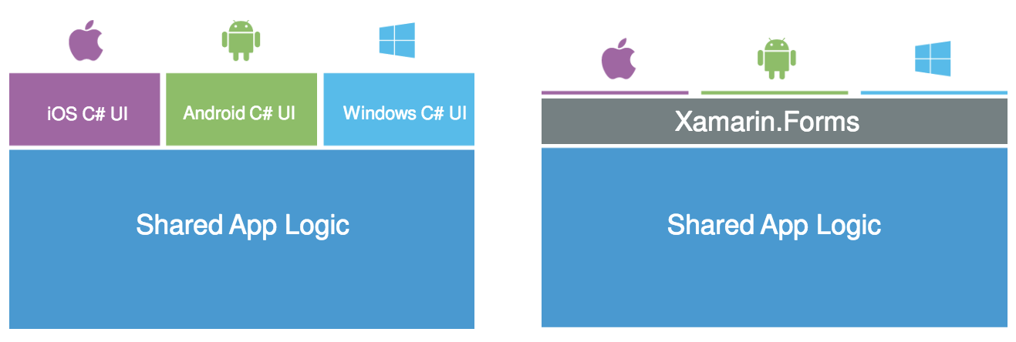
Share logic

Slide 7
1.4m
has a community of over 1.4 million developers

Slide 8
advantage
User Interface
Shared app logic
Xamarin Test Cloud
API Integration flexibility
its utmost flexibility to use same APIs and UI controls as found in developing Android, iOS and Mac applications.
code logic that can be written just once
freedom to choose User Interface layout
The cloud lets you test any app on thousands of devices

Slide 9


Use of advantage
Small team
fast

Slide 10
disadvantage
App overhead
community support
Can’t share codes
manual coding
Developers cannot share codes with other developers or teams if they are using only Swift, Java and Objective C
The UI development for each platform will be time consuming, especially since it has to be done manually.
This could affect download time and storage space required for app in user devices.
compared to other, Xamarin is relatively new, so the community still has to develop

Slide 11


Don’t use xamarin
games
Heavy animation

Slide 12
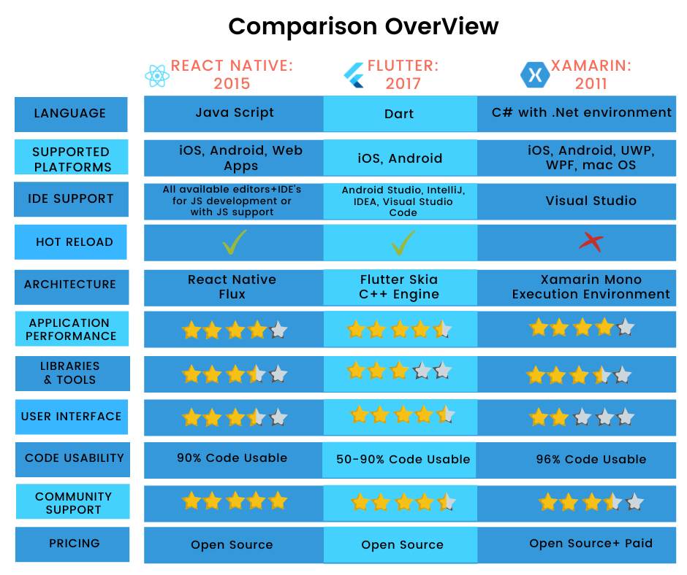

Slide 13

Installation
2.3 GB to 60 GB
1 GB to 80 GB

Slide 14


Slide 15
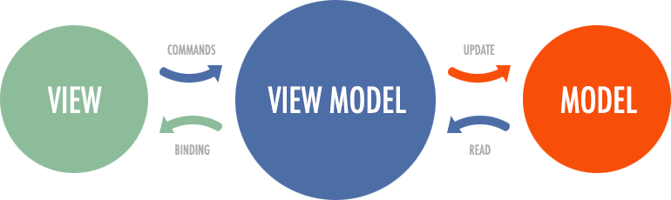
MVVM

Slide 16


View model
command
properties

Slide 17
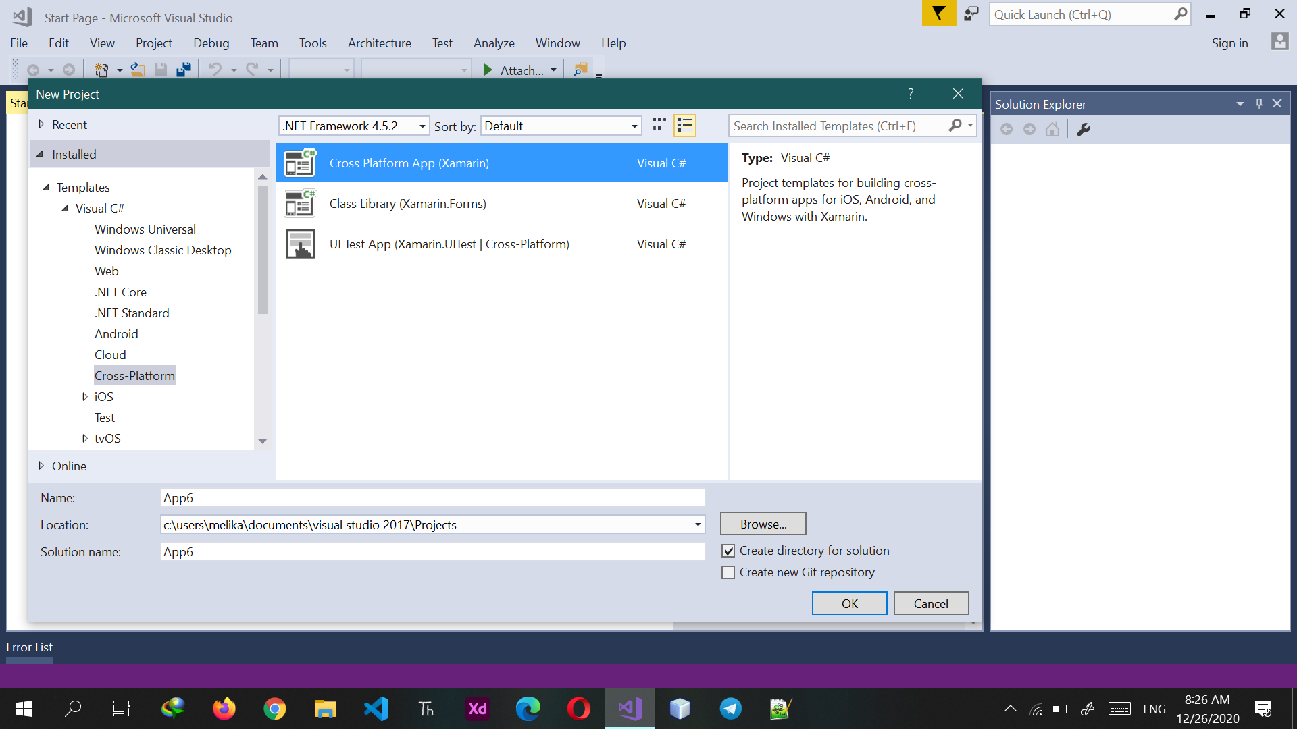

Slide 18
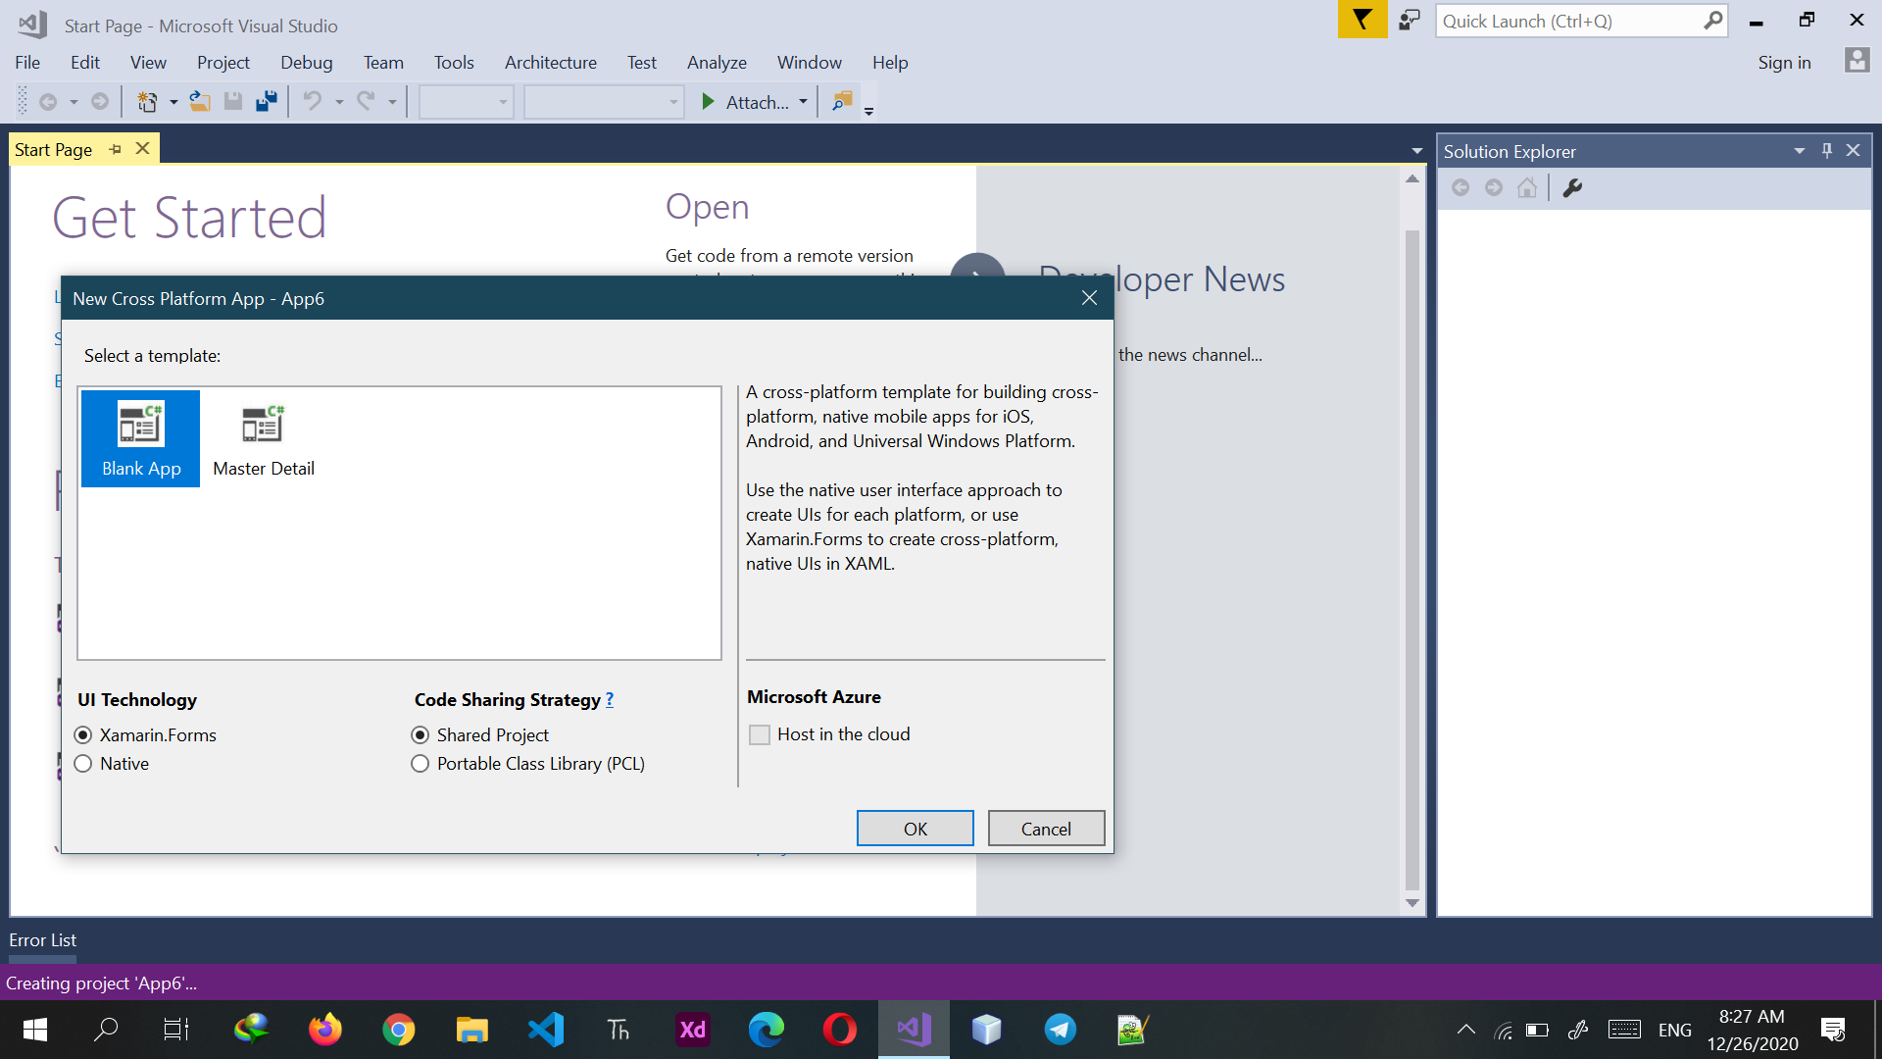

Slide 19
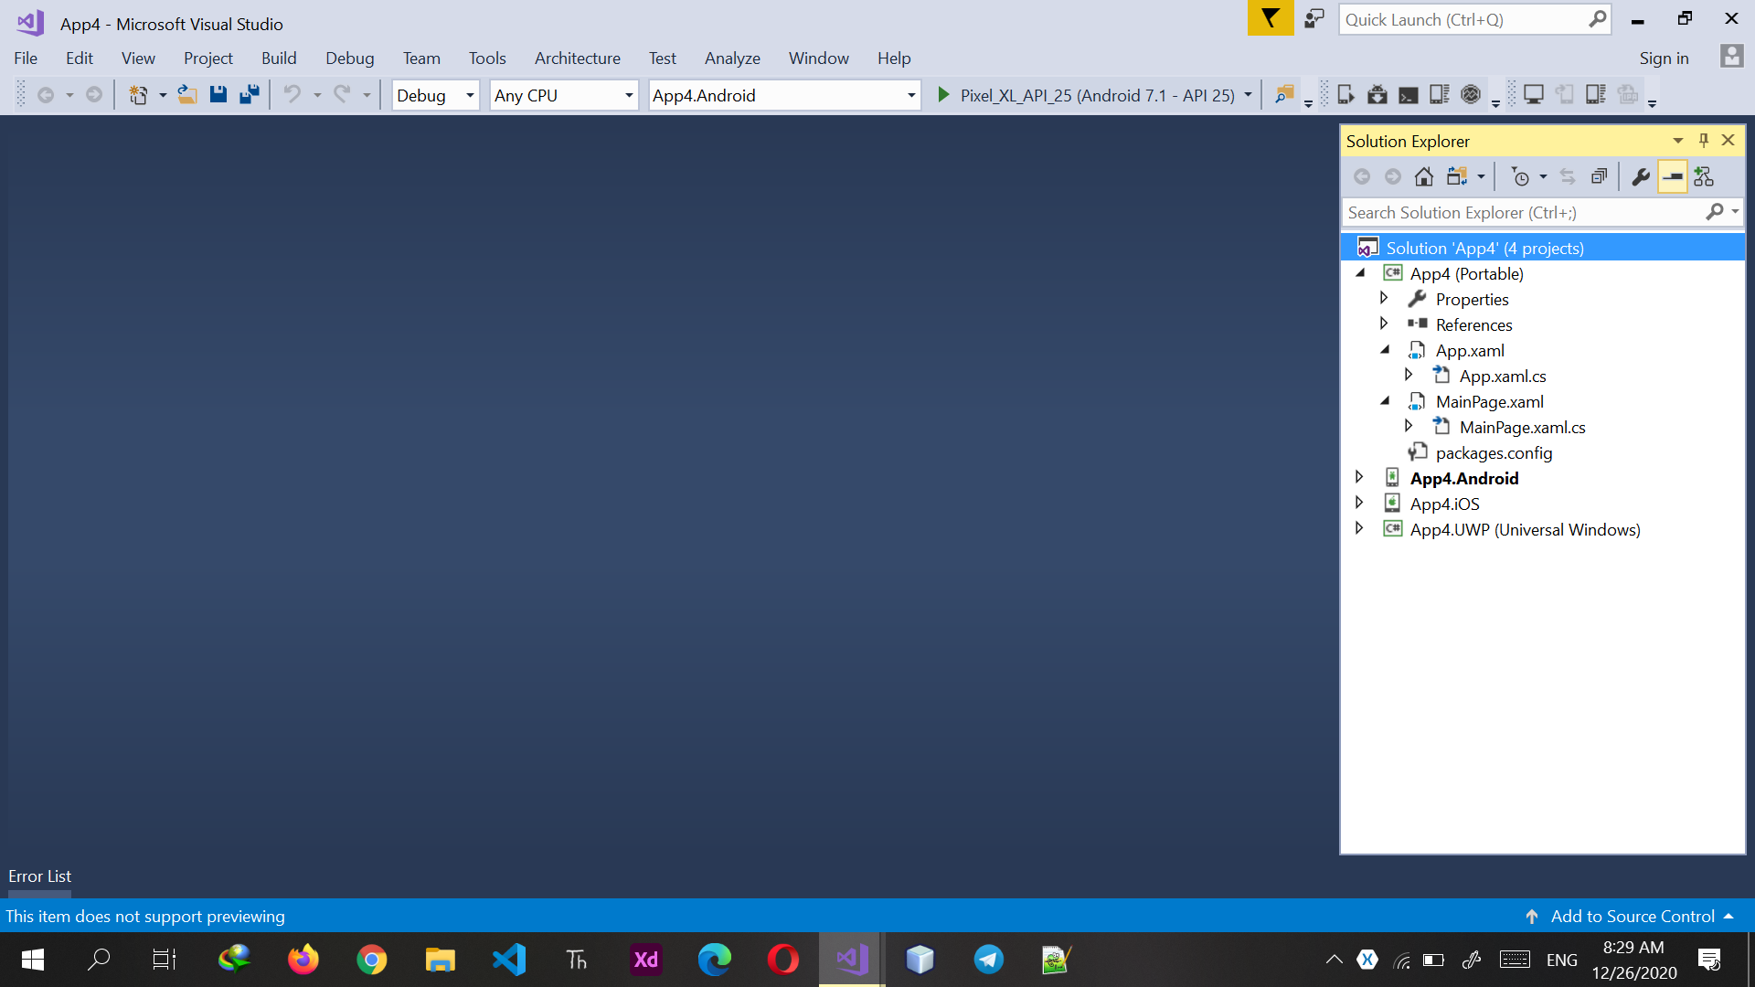

Slide 20
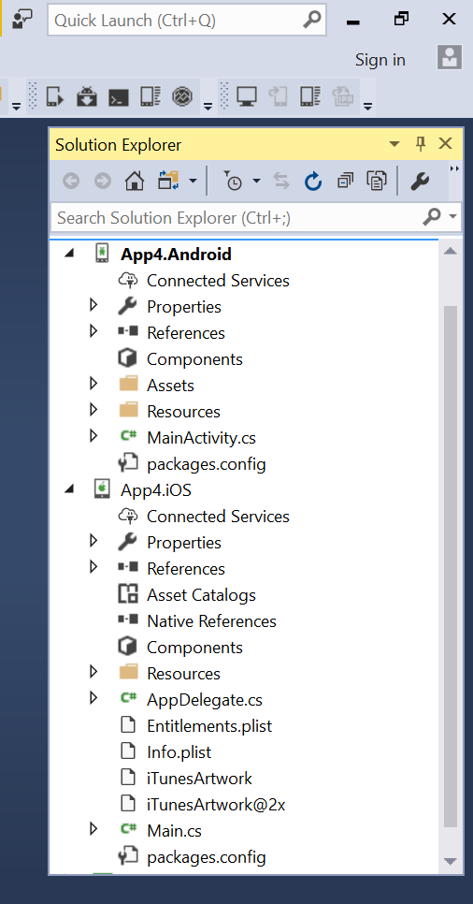
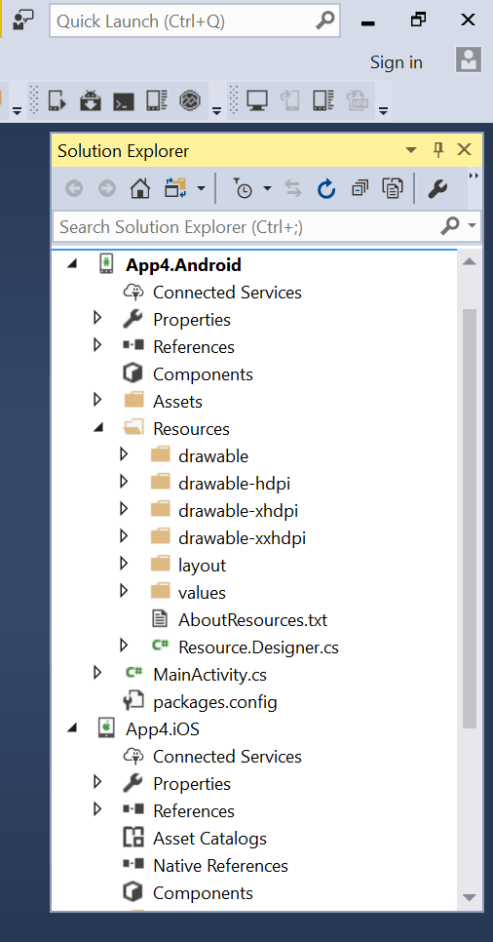
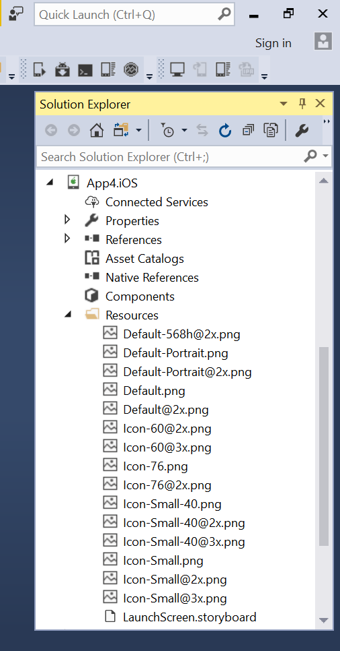

Slide 21
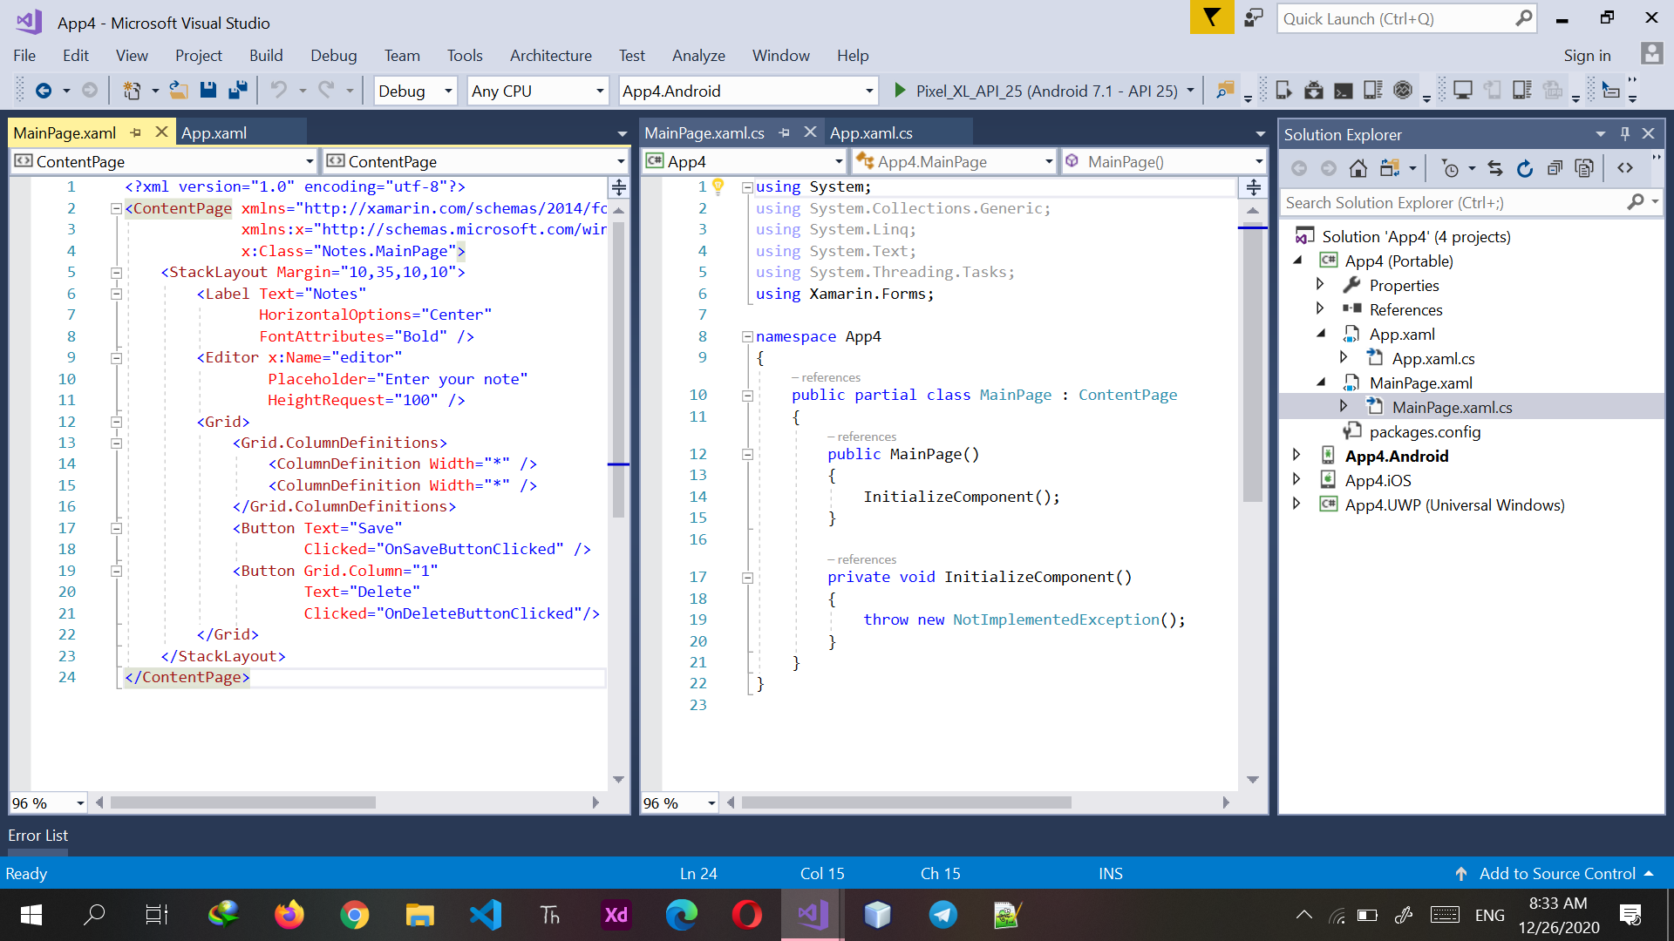

Slide 22
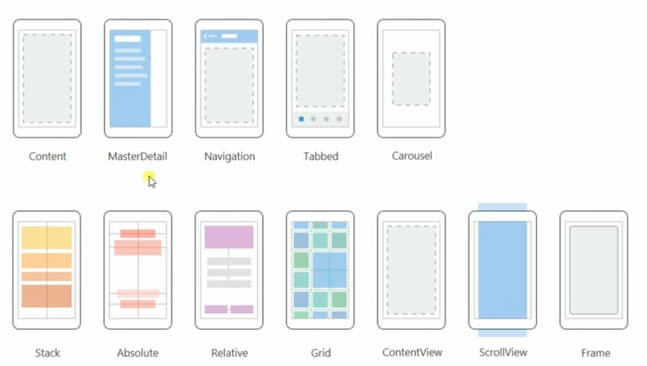
Pages
Layouts

Slide 23
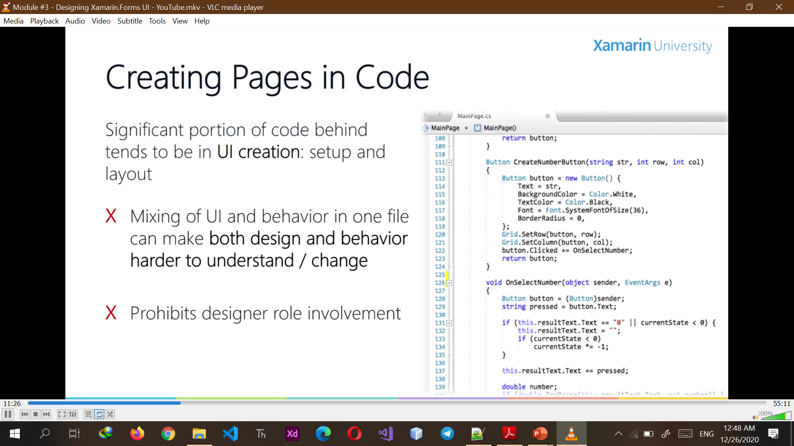
Creating Pages in Code
Significant portion of code behind tends to be in UI creation: setup and layout
Mixing of UI and behavior in one file can make both design and behavior harder to understand / change
Prohibits designer role involvement

Slide 24
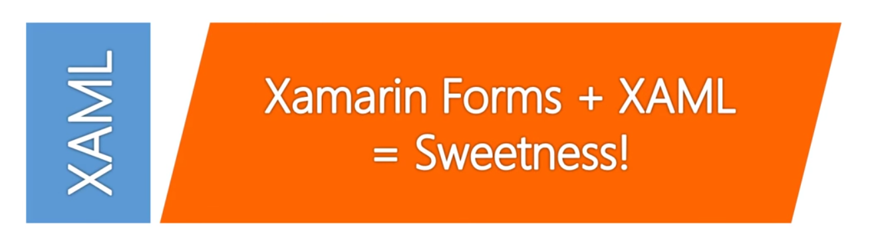
Extensible Application Markup Language
XAML was created by Microsoft specifically to describe UI

Slide 25
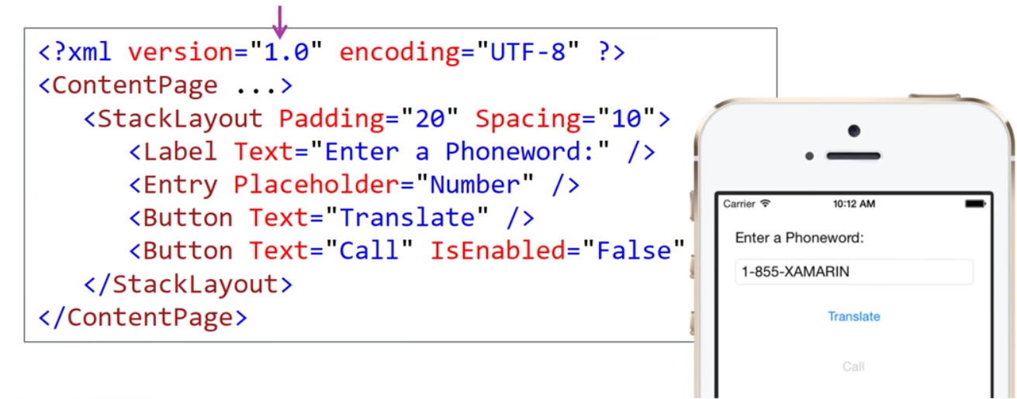
Creating a page in XAML
XAML is used to construct object graphs, in this case a visual Page
XML based: case sensitive, open tags must be closed, etc.

Slide 26
Creating a page in XAML
XAML is used to construct object graphs, in this case a visual Page
XML based: case sensitive, open tags must be closed, etc.
Attributes set properties or events
Element tags create objects

Slide 27
Creating a page in XAML
XAML is used to construct object graphs, in this case a visual Page
XML based: case sensitive, open tags must be closed, etc.
Attributes set properties or events
Element tags create objects
Child nodes used to stablish relationship

Slide 28
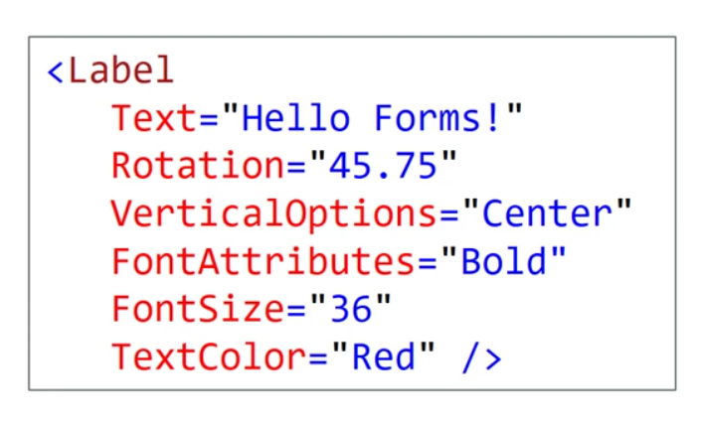
Property Conversions
XML attributes only allow for string values – works fine for intrinsic types
Enums are matched by name, use comma separators to combine flags
XAML invokes type convertors to convert string to proper type

Slide 29
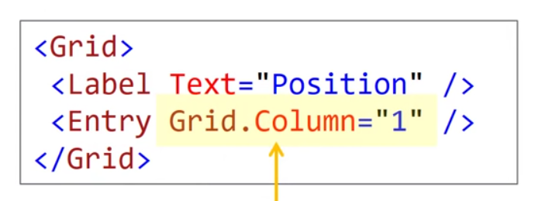
Setting Attached Properties
Attached Properties provide runtime “attached” data for a visual element, this is primarily used by layout containers to provide container-specific values on each child.
Recall that in code behind we used static methods on the layout containers to associate these values
Set in XAML with OwnerType.Property=“Value” form, can also use property-element syntax for more complex values

Slide 30
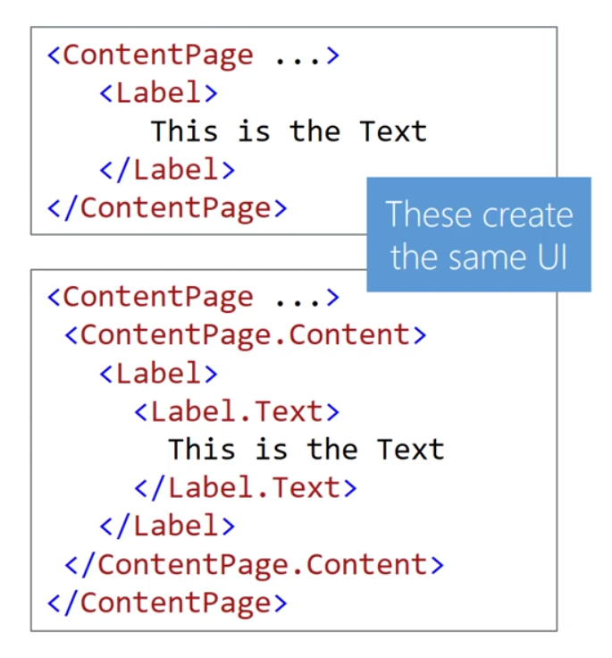
Content Properties
Some types have a default property which is set when child content is added to the element
This is the Content Property and is identified through a [ContentAttribute] applied to the class

Slide 31
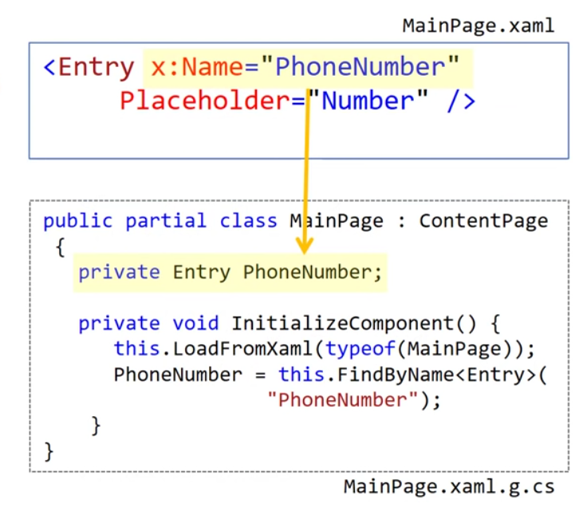
Naming Elements in XAML
Use x:Name to assign field name
Allows you to reference element in XAML and code behind
Adds a private field to the XAML-generated partial class (.g.cs)
Name must conform to C# naming conventions and be unique in the field

Slide 32
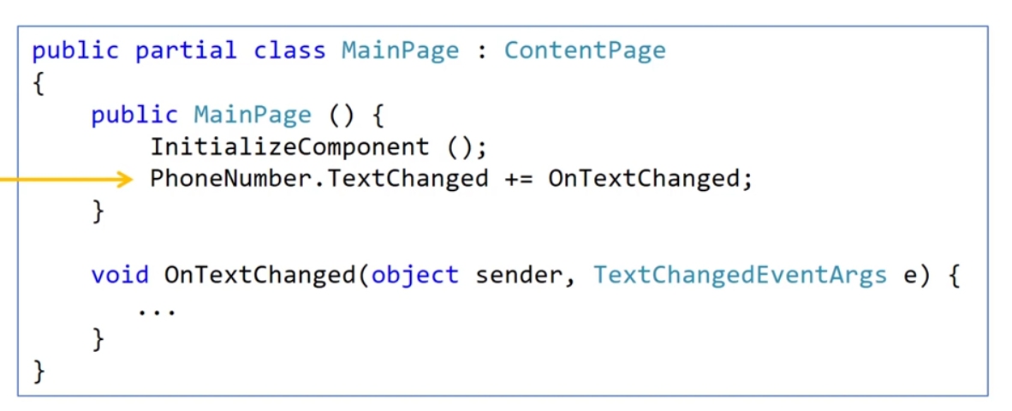
Working with named elements
Can work with named elements as if you defined them in code, but keep in mind the field is not set until after InitializeComponent is called.
Can wire up events, set properties, even add new elements to layout

Slide 33
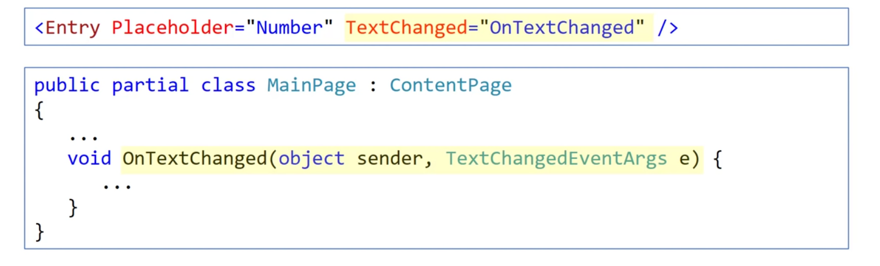
Handling events in XAML
Can also wire up events in XAML – event handler must be defined in the code behind file and have proper signature or it’s a runtime failure

Slide 34
Handling events in code behind
Many developers prefer to wire up all events in code behind by naming the XAML elements and adding event handlers in code
Keeps the UI layer “pure” by pushing all behavior + management into the code behind
Names are validated at compile time, but event handlers are not
Easier to see how logic is wired up
Pick the approach that works for your team / preference

Slide 35
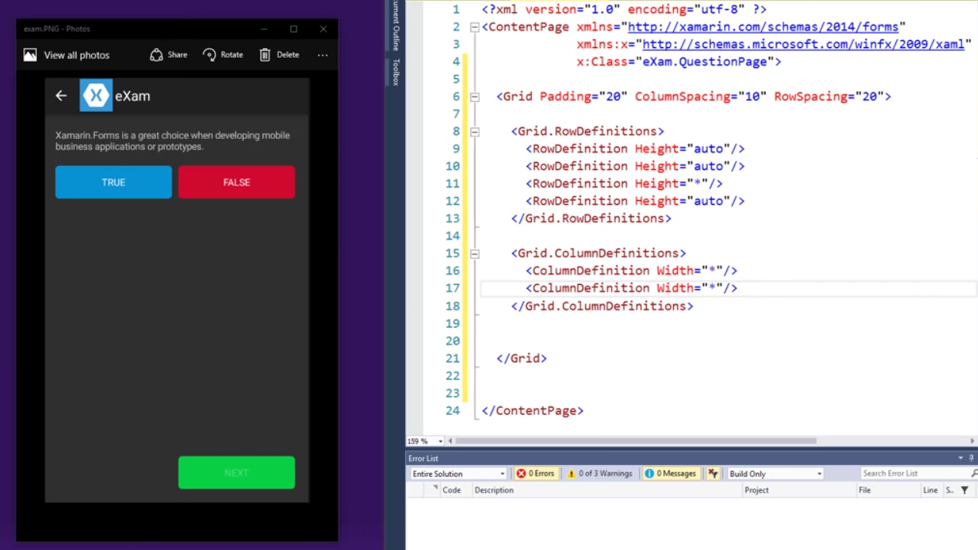

Slide 36
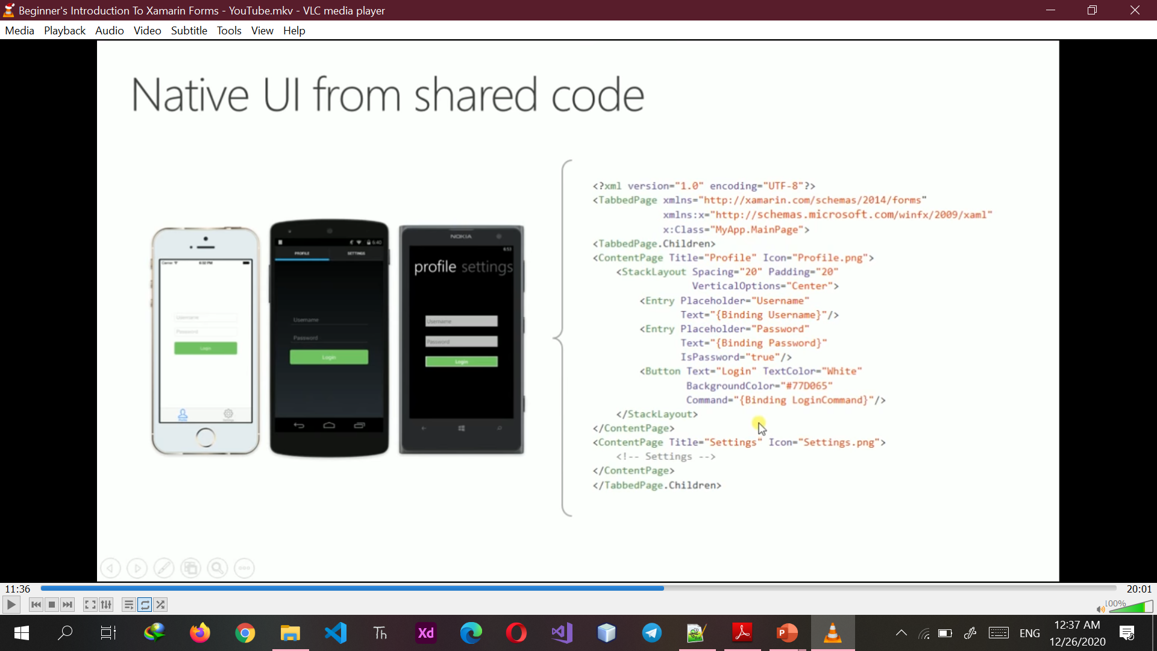

Slide 37
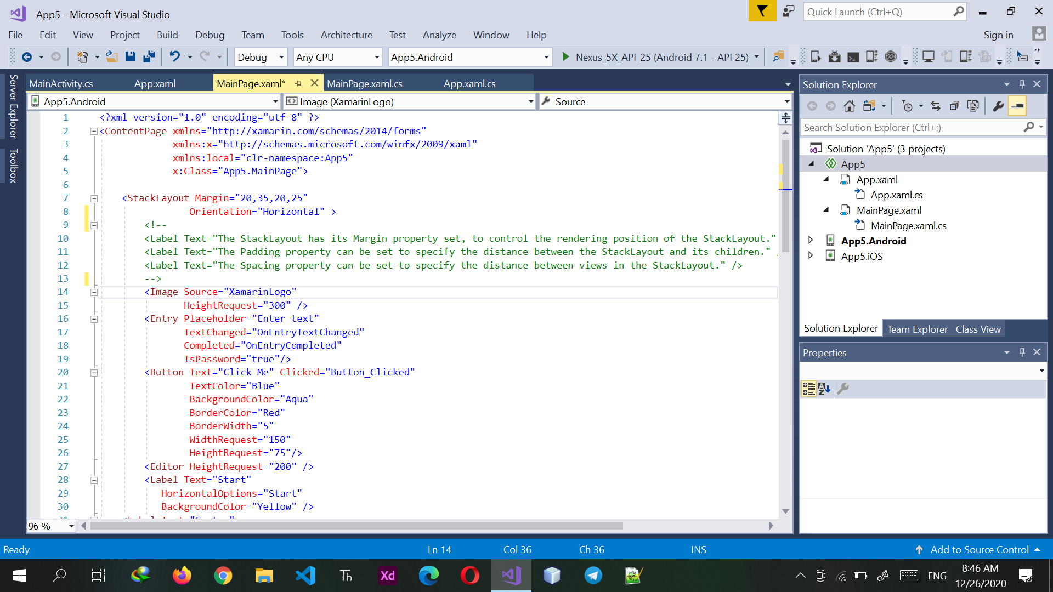

Slide 38
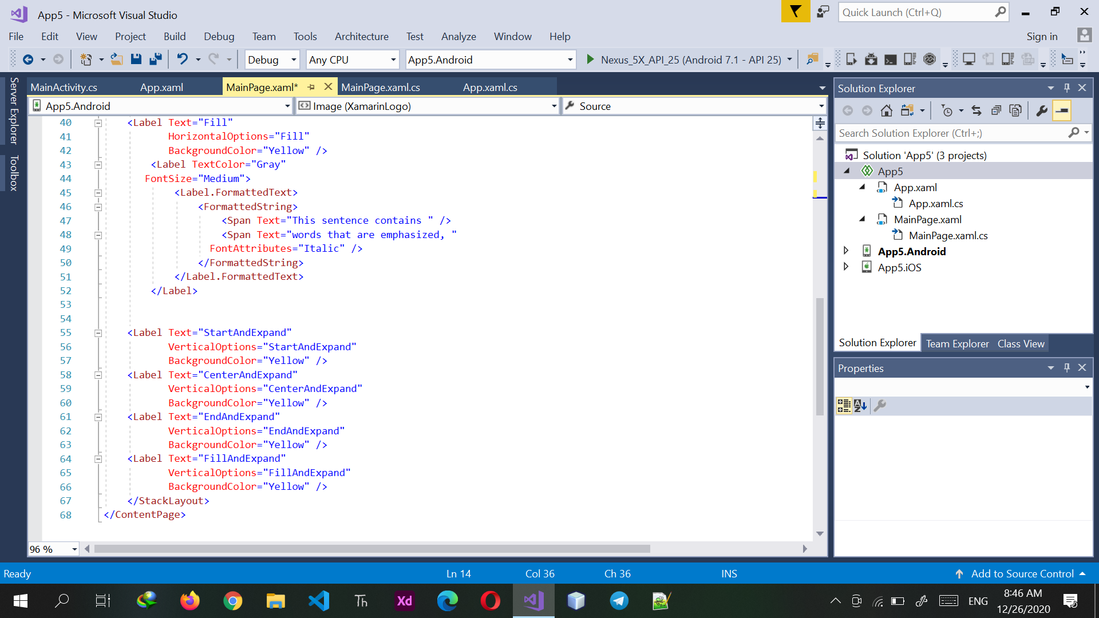

Slide 39
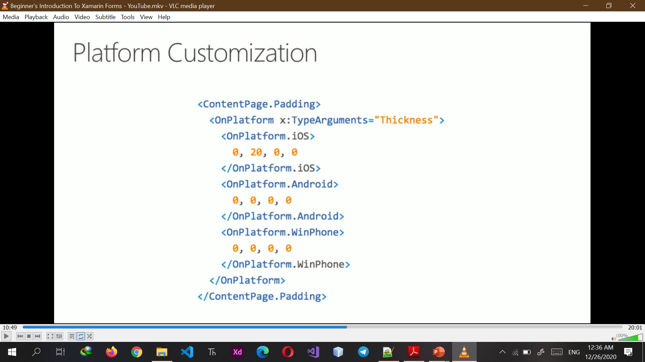
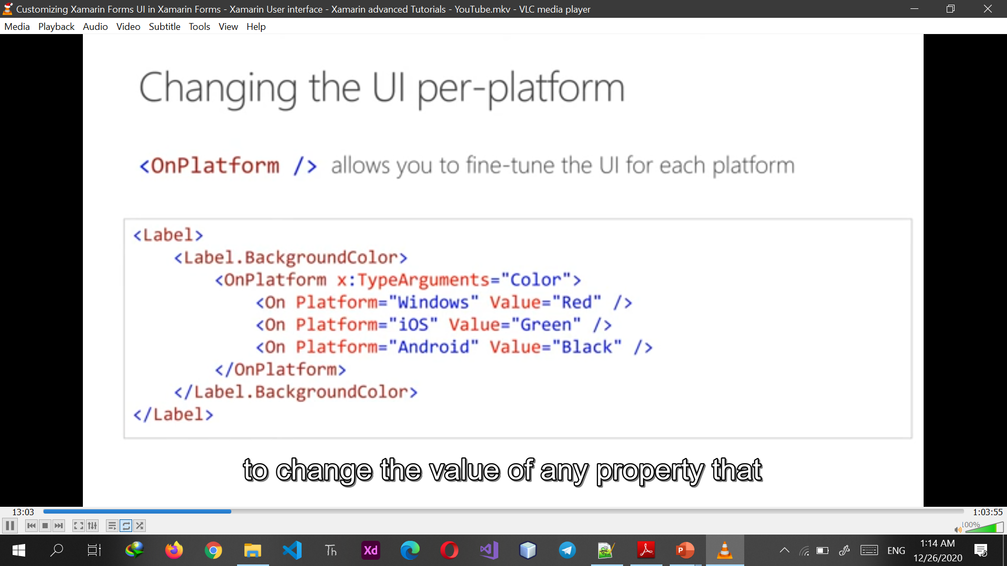
Changing the UI per-platform
<OnPlatform /> allows to fine-tune the UI for each platform

Slide 40
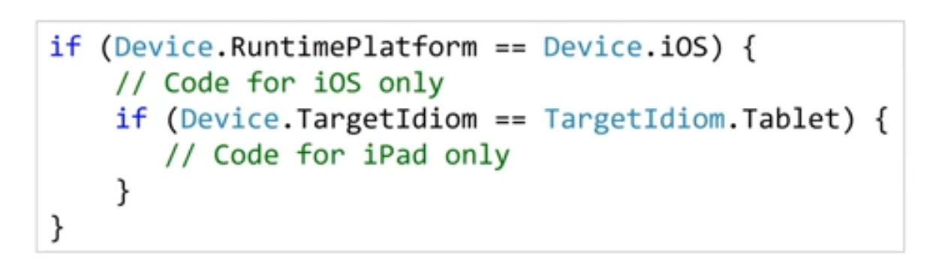
Detecting the platform
Can use the static Device class to identify the platform and device style

Slide 41
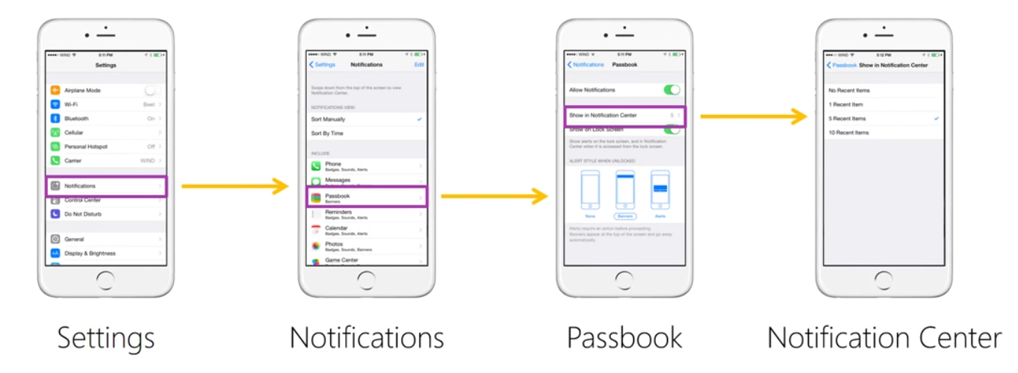
Working with multiple pages
Stack navigation is a common paradigm used in mobile apps to display hierarchies of related information

Slide 42
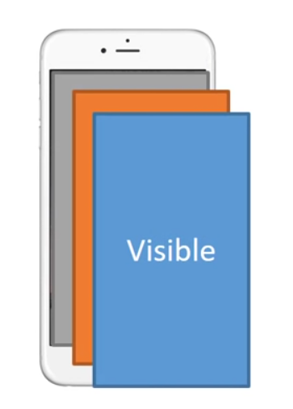
Stack Navigation
When a new page is pushed onto the stack, it becomes visible and hides the previous page
Only one page is over visible at a time (the last one added)
Great for displaying multi-level relationships because it allows “drilling” into details

Slide 43
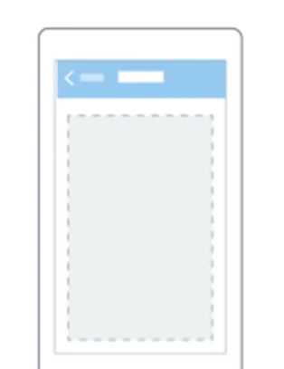
NavigationPage
Xamarin.Forms implements this through a special decorator page – NavigationPage which implements a navigation API to manipulate the current page

Slide 44
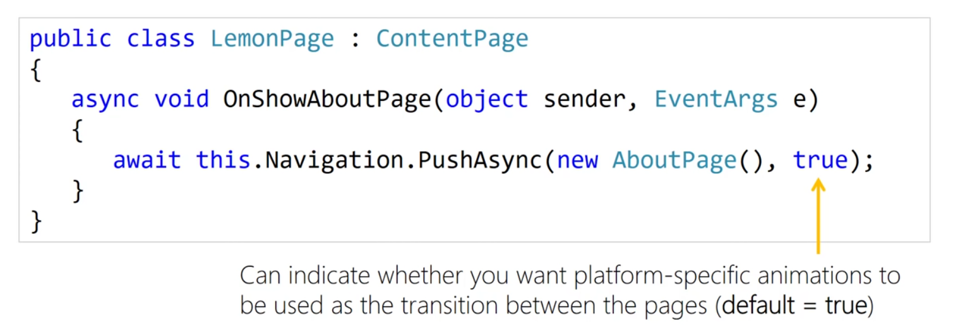
Pushing pages onto the navigation stack
Each Page has a Navigation property which exposes the navigation API, can use this to manipulate the navigation stack

Slide 45
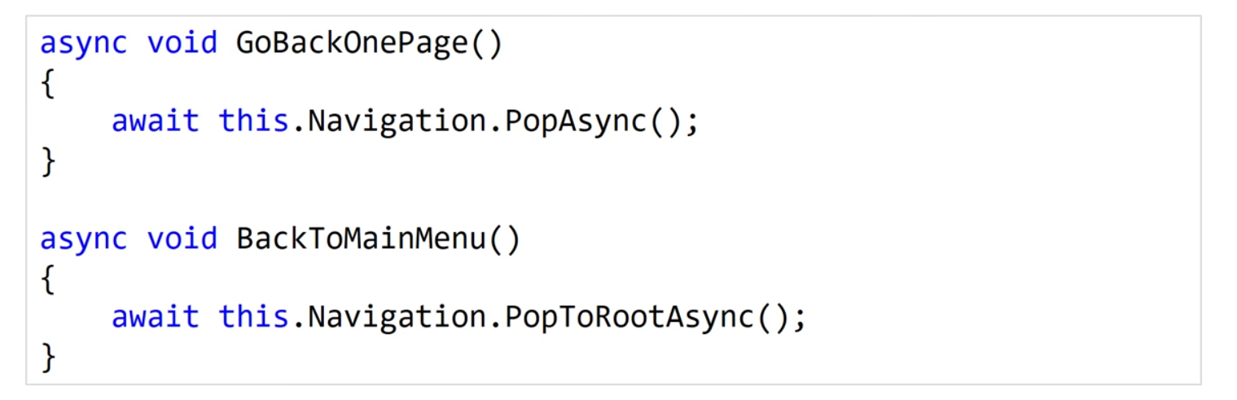
Returning to the previous page
Back button allows user to return to the previous screen, but can also preform this operation through the navigation API (with optional animation)

Slide 46
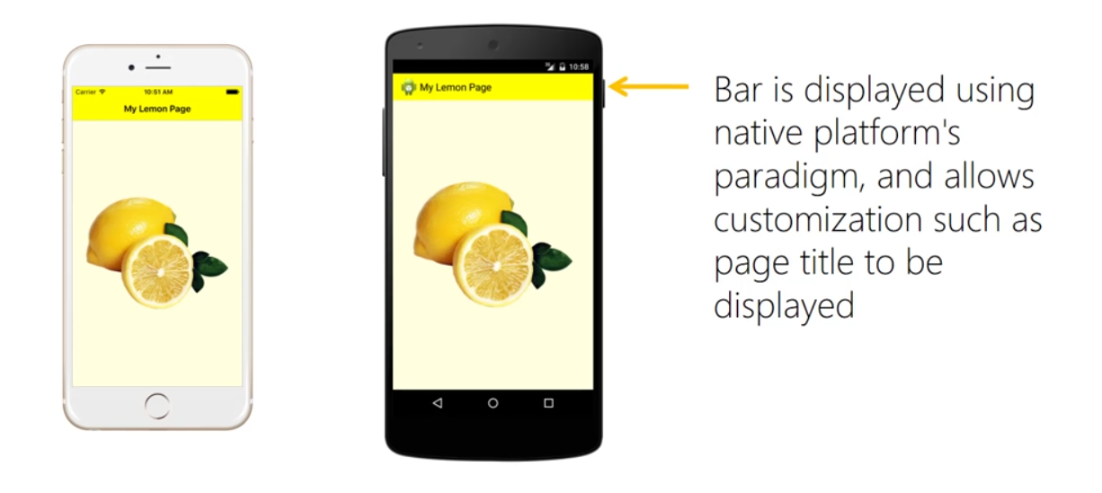
What does NavigationPage do?
NavigationPage activates a navigation bar in the UI – this is what will allow the user to interactively move backward in the stack

Slide 47
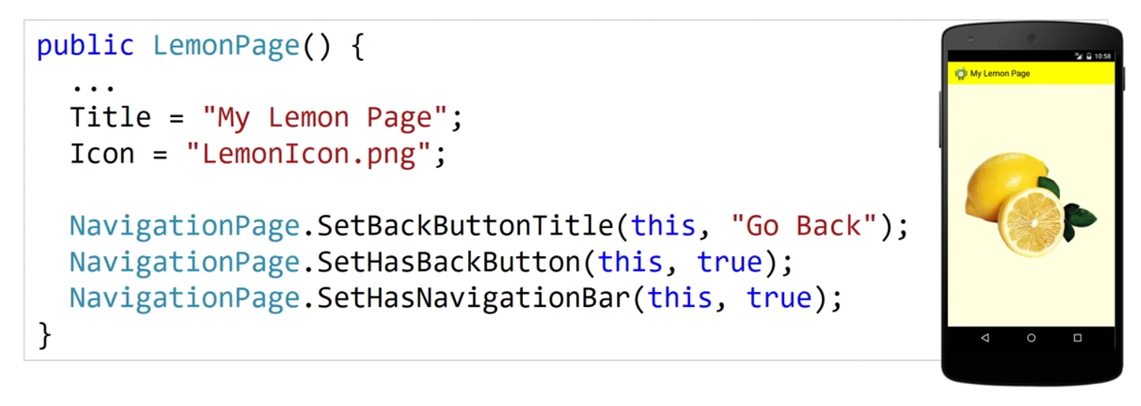
Customizing a page’s view
Can use properties on both the navigation page and the current page to customize the UI displayed for the active screen

Slide 48
THANKS!
Do you have any questions?
raminrowshan153@gmail.com
melikaaa98@yahoo.com
https://www.linkedin.com/in/raminRowshan

